Slide 1
CENG 3005
Database Management Systems
Week 3
ER Diagrams

Slide 2
Outline of Today
ER Diagram: Entity Relationship Diagram
What’s an Attribute?
  Multi-valued attribute, Derived Attribute
Cardinality concept
  One-to-One, Many-to_Many, One-to-Many, Many-to-Many
What’s a Key
  Superkey, Candidate key, Primary key, Discriminator (Partial key)

Slide 3
Database Design
The process of designing the general structure of the database:
Logical Design – Deciding on the database schema. Database design requires that we find a “good” collection of relation schemas.
  Business decision – What attributes should we record in the database?
  Computer Science decision – What relation schemas should we have and how should the attributes be distributed among the various relation schemas?
Physical Design – Deciding on the physical layout of the database (what are your “tables”)

Slide 4
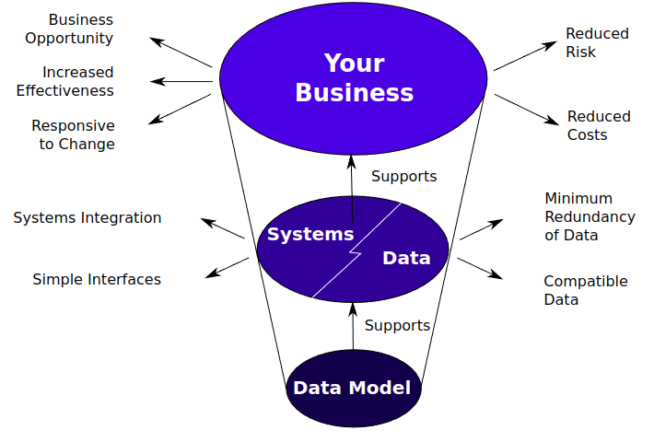

Slide 5
Database Modeling
and
Implementation Process
Ideas
ER Design
Relational Schema
Relational Database
Implementation

Slide 6

The Entity-Relationship Model
(aka ER-Model)
Models an enterprise as a collection of entities and relationships
  Entity: a “thing” or “object” in the enterprise that is distinguishable from other objects
    Described by a set of attributes
  Relationship: an association among several entities
Represented diagrammatically by an entity-relationship diagram:

Slide 7
Summary:
Why Split Information Across Relations?
Storing all information as a single relation such as
bank(account_number, balance,customer_name, ...)
  repetition of information
    e.g.,if two customers own an account (What gets repeated?)
  the need for null values
    e.g., to represent a customer without an account
Normalization theory deals with how to design relational schemas

Slide 8

Example Bank Schema

Slide 9
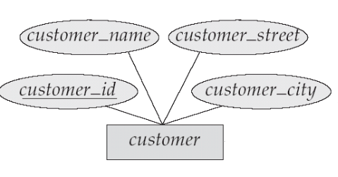
Attributes
An entity is represented by a set of attributes, that is descriptive properties possessed by all members of an entity set.
Domain – the set of permitted values for each attribute
Attribute types:
  Simple and composite attributes.
  Single-valued and multi-valued attributes
    Example: multivalued attribute: phone_numbers
  Derived attributes
    Can be computed from other attributes
    Example: age, given date_of_birth
customer = (customer_id, customer_name, customer_street, customer_city )
loan = (loan_number, amount )

Slide 10
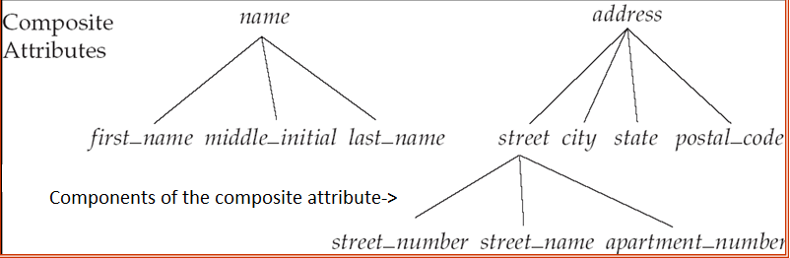
Composite Attributes

Slide 11
Criteria for selecting identifiers
Some entities have more than one candidate identifier
  Choose identifier that will not change in value over the life of each instance of the entity type
  Choose identifier that is guaranteed to have valid values and will not be null (or unknown).
  If composite, make sure all parts will have valid values

Slide 12
Criteria for selecting identifiers
Avoid the use of intelligent identifiers whose structure indicates classifications, locations or people that might change in time.
  e.g. the first two digits of an identifier may indicate a warehouse location, but such codes are often changed as conditions change, which renders them invalid.
Consider substituting new, simple identifiers for long, composite ones
  e.g. an attribute called Game_Number could be used for the entity type GAME instead of Home_Team and Away_Team

Slide 13
Mapping Cardinality Constraints
Express the number of entities to which another entity can be associated via a relationship set.
Most useful in describing binary relationship sets.
For each binary relationship, you need to set the mapping cardinality.
Ask yourself (and your customer): What’s the type of the relationship?
  One to One?
  One to Many?
  Many to One?
  Many to Many?

Slide 14
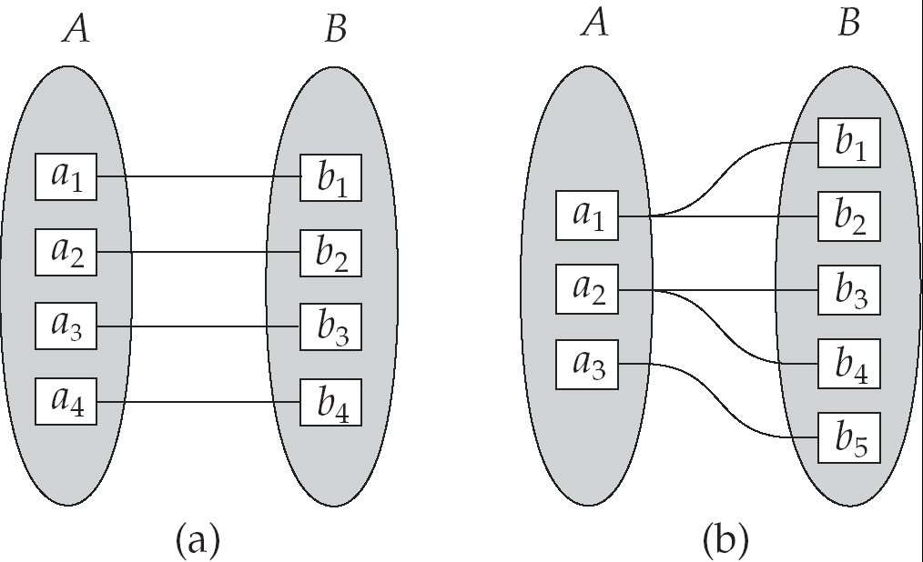
Mapping Cardinalities
One to one
One to many
Note: Some elements in A and B may not be mapped to any
elements in the other set

Slide 15
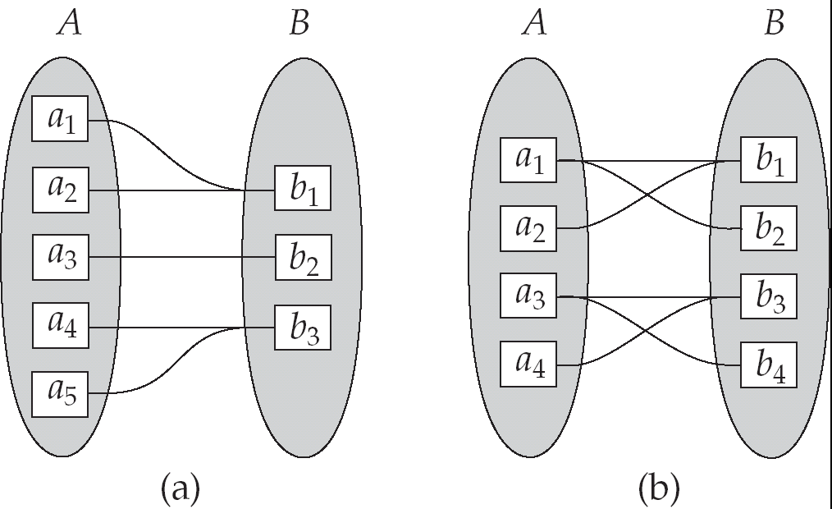
Mapping Cardinalities
Many to one
Many to many
Note: Some elements in A and B may not be mapped to any
elements in the other set

Slide 16
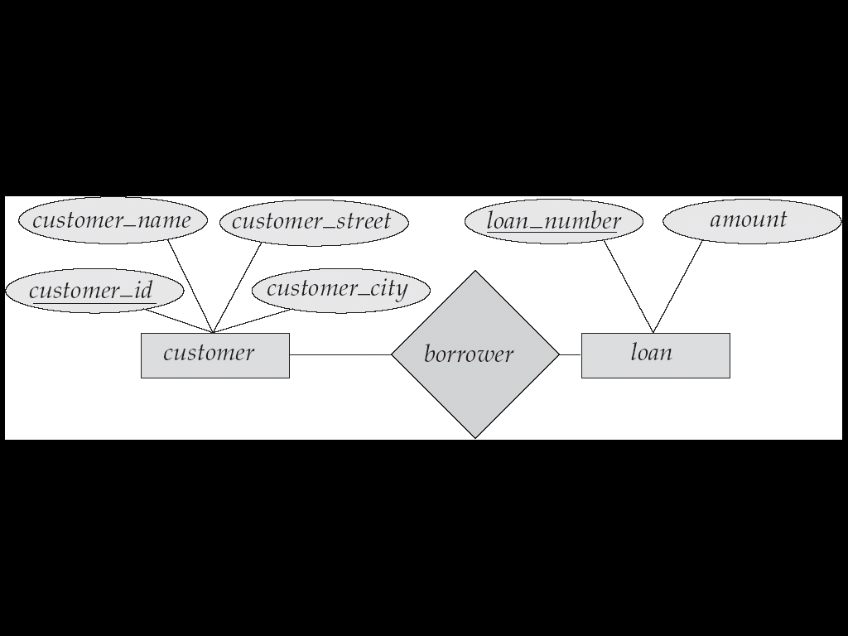
E-R Diagrams
Rectangles represent entity sets.
Diamonds represent relationship sets.
Lines link attributes to entity sets and entity sets to relationship sets.
Ellipses represent attributes
  Double ellipses represent multivalued attributes.
  Dashed ellipses denote derived attributes.
Underline indicates primary key attributes

Slide 17
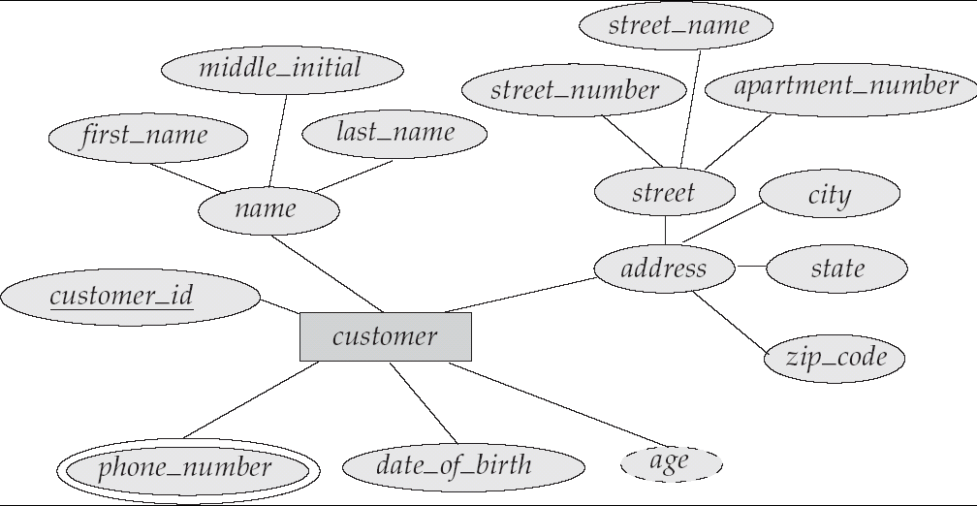
E-R Diagram with
Composite, Multivalued, and Derived Attributes

Slide 18
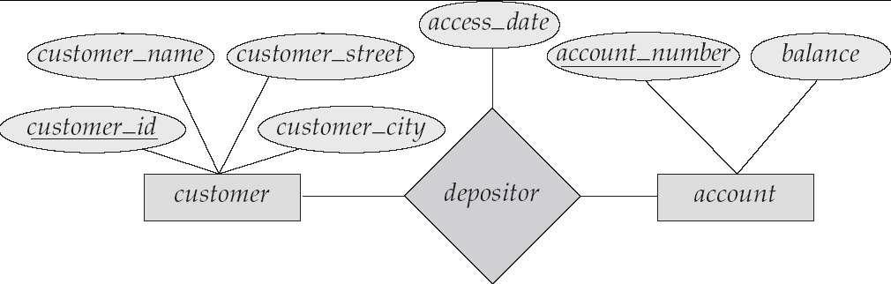
Relationship Sets with Attributes

Slide 19
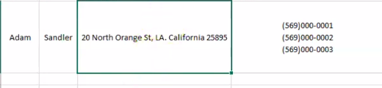

Slide 20
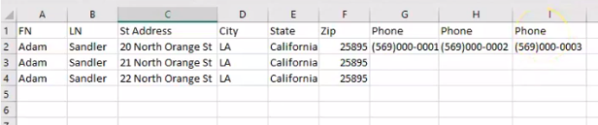
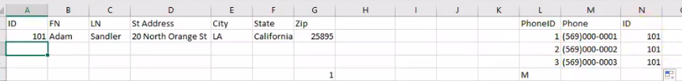

Slide 21
Keys
A super key of an entity set is a set of one or more attributes whose values uniquely determine each entity.
A candidate key of an entity set is a minimal super key
  Customer_id is candidate key of customer
  account_number is candidate key of account
Although several candidate keys may exist, one of the candidate keys is selected to be the primary key.

Slide 22
Keys for Relationship Sets
The combination of primary keys of the participating entity sets forms a super key of a relationship set.
  (customer_id, account_number) is the super key of depositor
  NOTE: this means a pair of entity sets can have at most one relationship in a particular relationship set.
    Example: if we wish to track all access_dates to each account by each customer, we cannot assume a relationship for each access. We can use a multivalued attribute though
Must consider the mapping cardinality of the relationship set when deciding what are the candidate keys
Need to consider semantics of relationship set in selecting the primary key in case of more than one candidate key

Slide 23
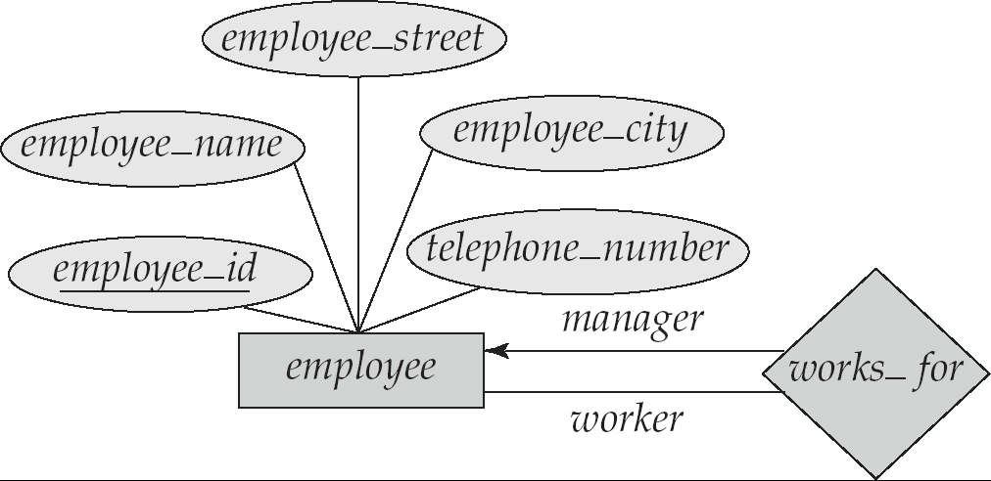
Roles
Entity sets of a relationship need not be distinct
The labels “manager” and “worker” are called roles; they specify how employee entities interact via the works_for relationship set.
Roles are indicated in E-R diagrams by labeling the lines that connect diamonds to rectangles.
Role labels are optional, and are used to clarify semantics of the relationship

Slide 24
E-R Diagram with
Composite, Multivalued, and Derived Attributes

Slide 25
Relationship Sets with Attributes

Slide 26
Roles
Entity sets of a relationship need not be distinct
The labels “manager” and “worker” are called roles; they specify how employee entities interact via the works_for relationship set.
Roles are indicated in E-R diagrams by labeling the lines that connect diamonds to rectangles.
Role labels are optional, and are used to clarify semantics of the relationship

Slide 27
Cardinality Constraints
We express cardinality constraints by drawing either a directed line (→), signifying “one,” or an undirected line (—), signifying “many,” between the relationship set and the entity set.
One-to-one relationship:
  A customer is associated with at most one loan via the relationship borrower
  A loan is associated with at most one customer via borrower

Slide 28

One-To-Many Relationship
In the one-to-many relationship a loan is associated with at most one customer via borrower, a customer is associated with several (including 0) loans via borrower

Slide 29
Many-To-One Relationships
In a many-to-one relationship a loan is associated with several customers via borrower, a customer is associated with at most one loan via borrower

Slide 30

Many-To-Many Relationship
A customer is associated with several (possibly 0) loans via borrower
A loan is associated with several (possibly 0) customers via borrower

Slide 31
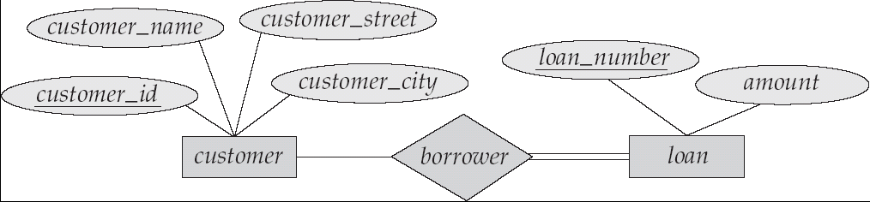
Total or Partial participation
Total participation (indicated by double line): every entity in the entity set participates in at least one relationship in the relationship set
  E.g. participation of loan in borrower is total
    every loan must have a customer associated to it via borrower
Partial participation: some entities may not participate in any relationship in the relationship set
  Example: participation of customer in borrower is partial

Slide 32
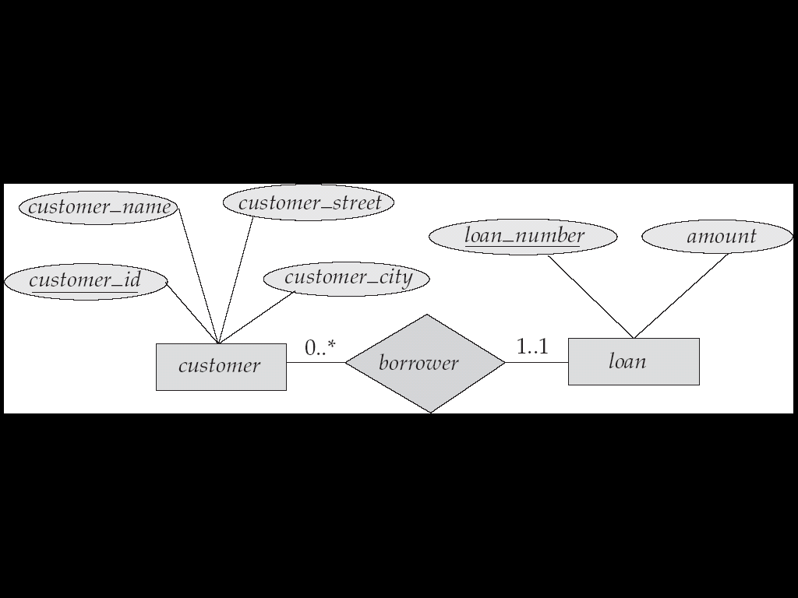
Alternative Notation for Cardinality Limits
Cardinality limits can also express participation constraints

Slide 33
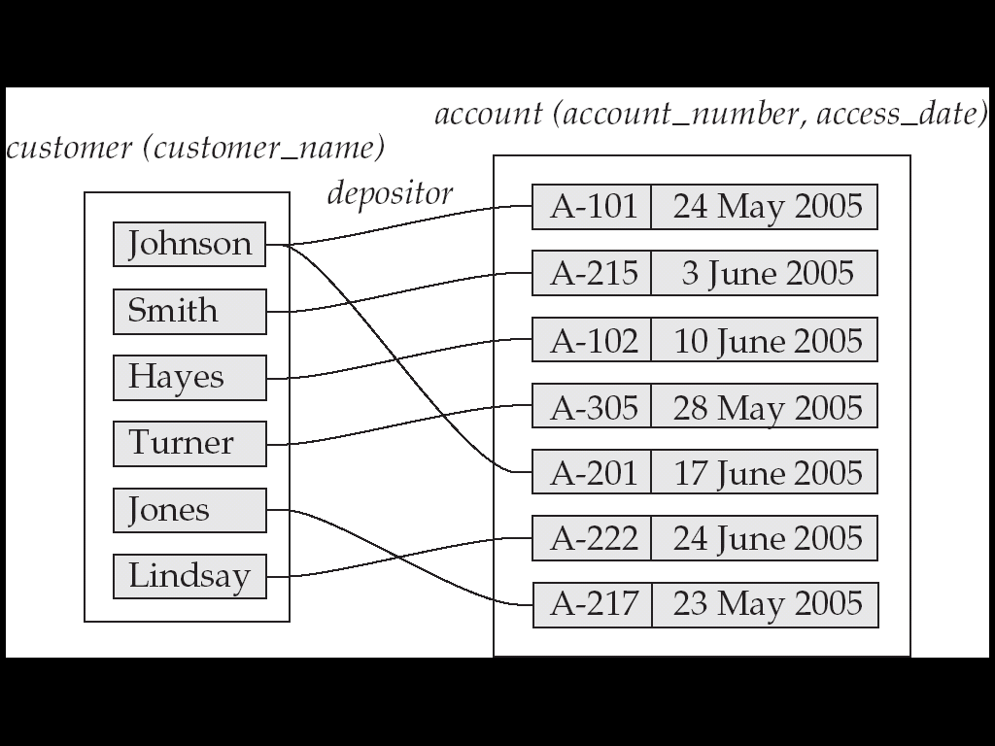
Mapping Cardinalities affect ER Design
Can make access-date an attribute of account, instead of a relationship attribute, if each account can have only one customer
  That is, the relationship from account to customer is many to one, or equivalently, customer to account is one to many

Slide 34
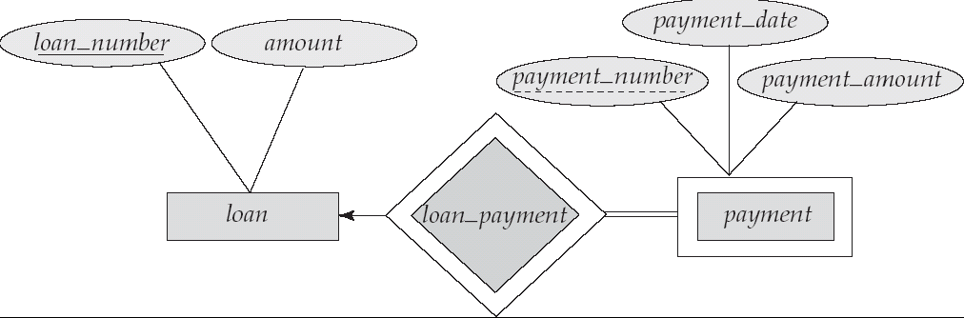
Weak Entity Sets
We depict a weak entity set by double rectangles.
We underline the discriminator of a weak entity set with a dashed line.
payment_number – discriminator of the payment entity set
Primary key for payment is the combination of the two strong entities (loan_number, payment_number)

Slide 35
Weak Entity Sets
An entity set that does not have a primary key is referred to as a weak entity set.
A weak entity set must relate to an identifying entity set via a total, one-to-many relationship set from the identifying to the weak entity set
  Identifying relationship depicted using a double diamond
The discriminator (or partial key) of a weak entity set is the set of attributes that distinguishes among all the entities of a weak entity set.
The primary key of a weak entity set is formed by the primary key of the strong entity set on which the weak entity set is existence dependent, plus the weak entity set’s discriminator.

Slide 36
Weak Entity Sets (Cont.)
Note: the primary key of the strong entity set is not explicitly stored with the weak entity set, since it is implicit in the identifying relationship.
If loan_number were explicitly stored, payment could be made a strong entity, but then the relationship between payment and loan would be duplicated by an implicit relationship defined by the attribute loan_number common to payment and loan

Slide 37
More Weak Entity Set Examples
In a university, a course is a strong entity and a course_offering can be modeled as a weak entity
The discriminator of course_offering would be semester (including year) and section_number (if there is more than one section)
If we model course_offering as a strong entity we would model course_number as an attribute.
Then the relationship with course would be implicit in the course_number attribute

Slide 38
Design Issues
Should I use entity sets or attributes?
Choice mainly depends on the structure of the enterprise being modeled, and on the semantics associated with the attribute in question.
Should I use entity sets or relationship sets?
Possible guideline is to designate a relationship set to describe an action(verb) that occurs between entities

Slide 39
Design Issues
Do I need any attribute for my relationship set?
Should I use a strong or a weak entity set ?
A strong entity set and its dependent weak entity sets may be regarded as a single “object” in the database, since weak entities are existence dependent on a strong entity

Slide 40
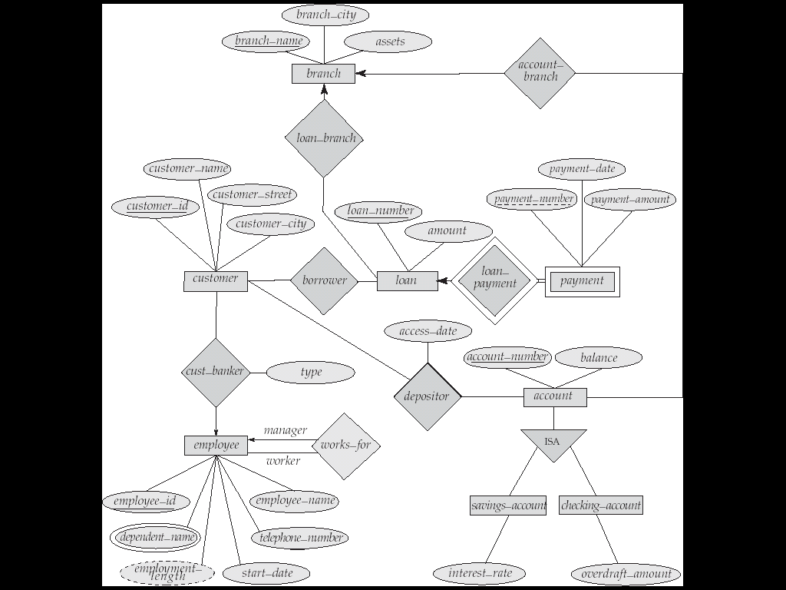

Slide 41
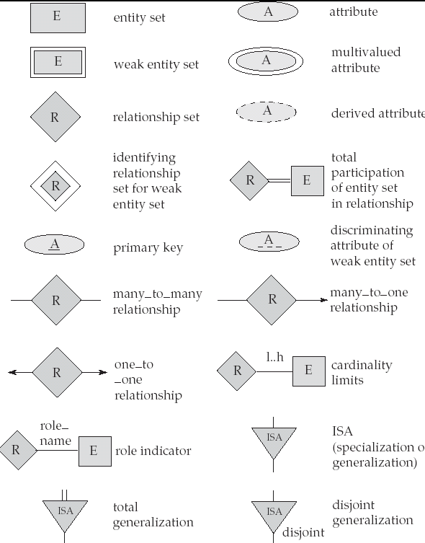
Summary of Symbols Used in E-R Notation

